Slide 1
CANCER DIAGNOSIS
Umarov Aliden
Temirbay Miras
Bekbossynov Asset

Slide 2
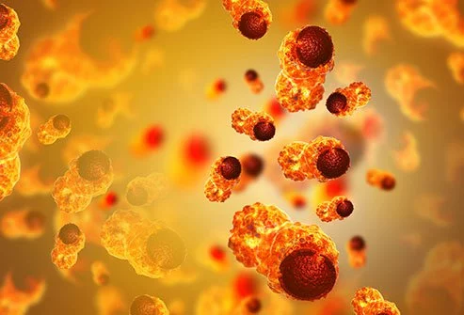
Cancer is a major public health problem worldwide
Every year thousands of people die of cancer

Slide 3

Main cause of that is the inability to diagnose cancer in its early stages

Slide 4
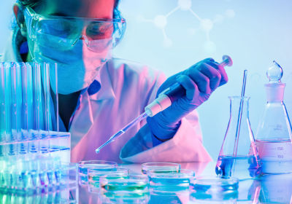
Every year a lot of scientists try to solve this problem and save human’s lives

Slide 5
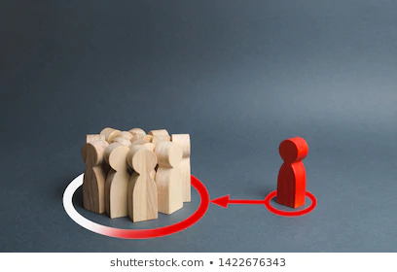
We want to exert our efforts to combat this disease

Slide 6
We will classify human cell to ‘malignant’ and ‘benign’ by next criteria:
1) Radius
2) Texture
3) Perimeter
4) Area
5) Smoothness
6) Compactness
7) Concavity
8) Concave points
9) Symmetry
10) Fractal dimension

Slide 7

According to the received data we will try to predict the risk of cancer disease

Slide 8
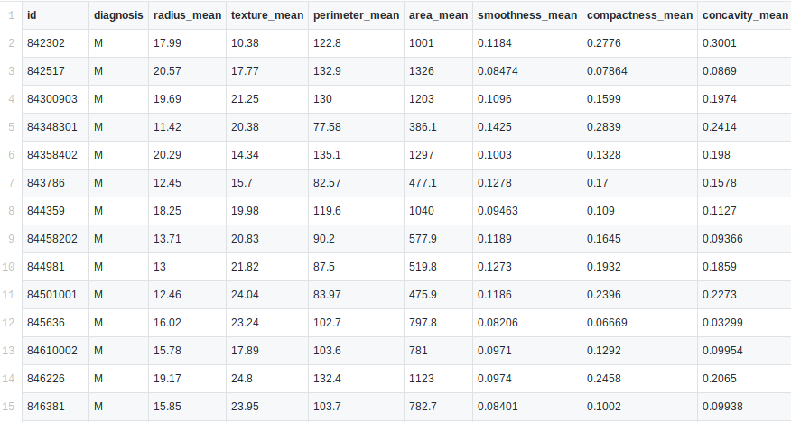
Dataset

